Slide 1
MATLAB Programming
Final Exam Two
Instructor: 黃世強 (Sai-Keung Wong)

Slide 2
Content
There are two problems. You must answer all of them.
You can create new files or functions.

Slide 3
About demo video and demo programs.
A demo video or a demo program may have bugs. They show or illustrate roughly the results. These results may not be exactly the same as the requirements. They are for your own reference. You must follow the instruction to finish your programs.

Slide 4
Program file name format
Write all your programs in a folder. The folder name is mat_exam_02_student_ID. For example, if your ID is 12345678, the folder name is mat_exam_02_12345678.
Zip the folder and upload it.
Write a program for each problem in one file.
The file name is ex02_X_yourStudentID.m, where X is the problem number.
For example, if your student ID is 12345678 and the problem number is 3, then the file name must be ex02_3_12345678.m.
You must not output all the intermediate results.
Output the results that are required only.

Slide 5
File content header
At the top of the file, write down your name, ID, email address, department, and date. If you do not do so, you receive a score of zero in the corresponding problem.
%%%%%%%%%%%%%%%%%%%%%%%%%%%
% Final Exam Number: …
% Problem number: …
% Student Name: …
% Student ID: …
% Email address: …
% Department:
% Date: ….
%%%%%%%%%%%%%%%%%%%%%%%%%%%%

Slide 6
File content
For each problem, display the problem number before showing the results.
close all; clear; clc; % close all windows
% clear variables, and clear screen
disp('Exam Problem 2.1') % show Exam Problem 2.1

Slide 7
(50%) Problem 2.1
Assume that Y is generated randomly in a uniform manner inside (0,1).
We have
X1 = F1(Y) = a cos ( π Y ² /2) - a
X2 = F2(Y) = a cos ( π Y ² /2) + a
Ask to input a. a must be in [-1, 1].
Ask to input the number of samples of Y. Let the number be n. Implement the following steps:
If n is zero, quit the program. n is inside [0, 1000000].
Ask to input a. If a is not inside [-1, 1], show a message and repeat step 2.

Slide 8
Problem 2.1.
Clear the figure(s). Use a 1x3 grid to draw figures.
Randomly generate n samples of Y.
Draw the pdf of Y. Use subplot(1,3, 1) to draw it on the left side.
Draw the pdf of X1. Use subplot(1,3, 2) to draw it in the middle.
Draw the pdf of X2. Use subplot(1,3, 3) to draw it on the right side.
Show the titles of the three figures similar to the demo figures.
Report the average (M) and standard deviation (SD) of the n samples as the title of the figure. Also, report a. The format is: Mean= …; SD= …; a=…;
Animate a point to move along the curve of the pdf of Y. Also, animate the corresponding points on the pdf curves of X1 and X2. The movement directions of the points must be correct.

Slide 9
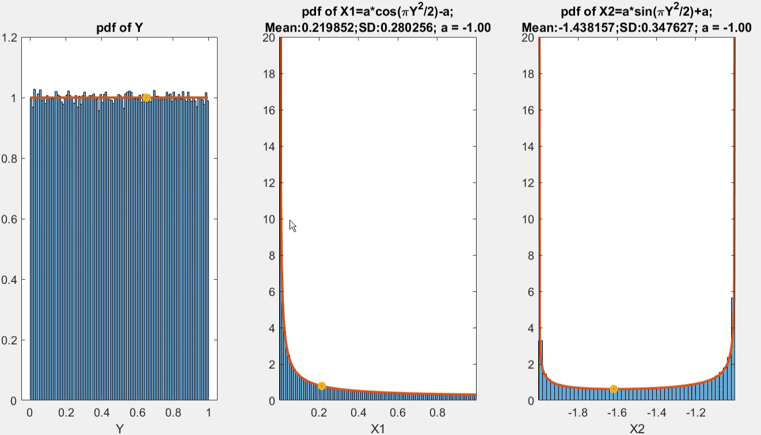
Problem 2.1. n = 500,000. a =-1.0 Play to see the animation

Slide 10
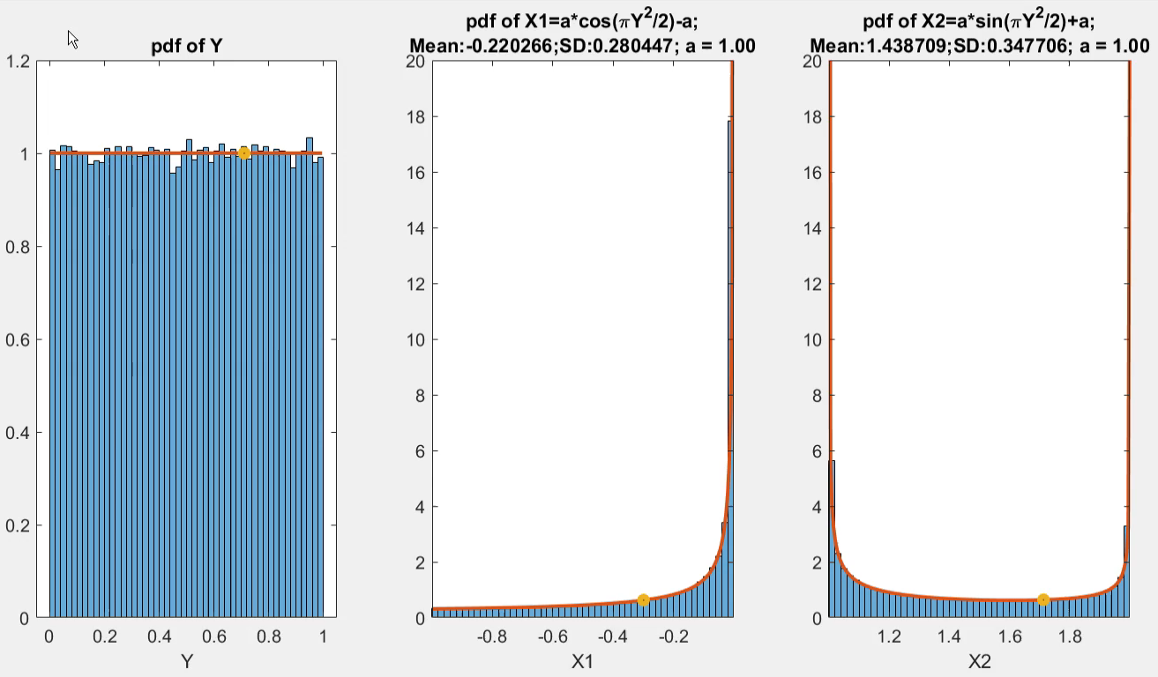
Problem 2.1. n = 200,000. a = 1.0 Play to see the animation

Slide 11
Problem 2.1. Marking Scheme
[5%] Draw the pdf of Y. Use subplot(1,3, 1).
[5%] Draw the pdf of X1. Use subplot(1,3, 2) to draw it in the middle.
[5%] Draw the pdf of X2. Use subplot(1,3, 3) to draw it on the right side.
[5%] Show the title of the left subplot.
[5%] Show the title of the middle subplot.
[5%] Show the title of the right subplot.
[5%] The point is animated correctly in the left subplot.
[10%] The point is animated correctly in the middle subplot.
[5%] The point is animated correctly in the right subplot.

Slide 12
Problem 2.2
This page is empty. Please go to the next page.

Slide 13
(50%) Problem 2.2.
There are two options.
Show student ID and name. % You implement this item or your score is zero.
Then show a message to ask for option.
Option 1) Function Graph
Option 2) Region filling
Enter the option:

Slide 14
Problem 2.2. Option 1. (30%)
The following diagrams show how the inputs are computed to produce new values. Note that if the inputs are vectors, operations are performed in the array format.
h
a
x
g
x
x
g
g(x)
g
g(x,y)
k
b
y
A function accepts one parameter, x. It produces a new value g(x).
y
A function accepts two parameters, x and y. It produces a new value g(x,y). Note the parameters must be ordered correctly.
This diagram performs:
a = h(g(x)), and b = k(g(x), y).

Slide 15
Problem 2.2. Option 1.
Write a program to implement the following diagrams:
g₂₁
g₃₁
g₄₁
g₅₁
x
g₁₁
g₂₂
g₃₂
g₄₂
g₁₂
g₂₃
g₃₃
y
g₂₄

Slide 16
Problem 2.2. Option 1.
We denote the output computed by function g_{ij} as k_{ij}. Note the order of the inputs is important.
a
a
k_{ij}
g_{ij}
k_{ij}
g_{ij}
b
b
k_{ij =} g_{ij}(a, b)
k_{ij =} g_{ij}(b, a)

Slide 17
Problem 2.2. Option 1.
We denote the output computed by function g_{ij} as k_{ij}. Note the order of the inputs is important.
a
a
g_{ij}
k_{ij}
g_{ij}
k_{ij}
b
c
c
b
k_{ij =} g_{ij}(a, b,c)
k_{ij =} g_{ij}(c,b, a)

Slide 18
Problem 2.2. Option 1.
Assume that the inputs are a and b. The functions are defined as follows.
Note that you must interpret the operators properly.
Layer1 | Layer 2 | Layer 3 | Layer 4 | Layer 5
g₁₁(a,b) = b.*sin(a) | g₂₁(a,b) = cos(b)/(cos²(a)+0.1) | g₃₁(a,b) = -a./(|b|+0.2) | g₄₁(a,b) = cos(a)+2.*sin(b) | g₅₁(a,b) = a.*b
g₁₂(a,b) = a.*cos(b) | g₂₂(a,b) = a.*b | g₃₂(a,b) = b.*sin(a) | g₄₂(a,b) = cos(b)./(sin(a)+2)
 | g₂₃(a,b) = sin(b)/(|a|+0.1) | g₃₃(a,b) = sin(a).*cos(b)
 | g₂₄(a,b) = a.*cos(b)

Slide 19
Problem 2.2. Option 1.
Set x in [-2.5, 2.5] and y in [-2.5, 2.5]. The step size is 0.05.
Plot each data set in F. A data set represents a mesh. Label the x-axis and the y-axis.
F = [k11; k12; k21; k22; k23; k24; k31; k32; k33; k41; k42; k51];
Hint: To draw a mesh, use the followings:
s0 = index*101+1-101; % Note kij’s dimension is 101x101.
s1 = index*101+101-101;
Z = F(s0:s1,:);
meshc(X,Y,Z)
colorbar
X and Y are produced by meshgrid.
Z contains the values for all the combinations of x and y in the grid of X and Y.

Slide 20
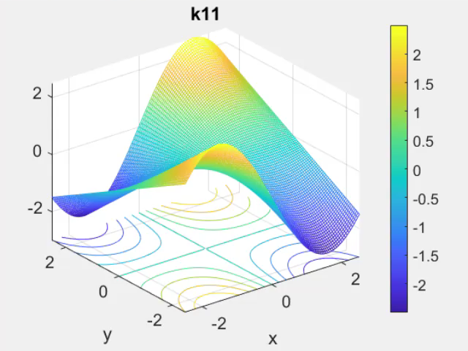
Problem 2.2. Option 1.
Play to see each item
Press ‘m’ to view each of the items in F in a backward order.
Press ‘n’ to view each of the items in F in a forward order.

Slide 21
Problem 2.2. Option 1. Notice that the labels of the x-axis and y-axis shows the ranges that are the same as what we set for x and y.

Slide 22
Problem 2.2. Option 2. Region filling (20%)
Given the following two functions:
y1(x) = (x-2)(x+2) y2(x) = -2(x+2)(x-2)sin(x/4) Each function is represented as a curve in the 2D Cartesian space. | Initially, r1 = -4, r2 = r4 Constraint: r1 <= r2
Fill two kinds of regions for x inside [r1, r2]: The region(s) bounded between two curves. Fill the region(s) in blue. The region below the two curves. Fill the region in yellow. You must implement a program to produce the same results as shown in the demo video.

Slide 23
Problem 2.2. Option 2. Region filling (20%)
Fill the region(s) correctly for x inside [r1,r2].
Draw the curve for each function for x inside [-5, 5]. The line width is 5. So that the two curves are drawn on top of the filled region(s). The curves are drawn in different colors.
Show the (r1,r2) as the figure title.
Use axis([-5 5 -20 20]).
Press ‘b’ to reset r1 and r2 to their intial values.
Press ‘n’ to increase r1 by 1. r1 cannot be larger than r2. Redraw everything.
Press ‘m’ to decrease r2 by 1. r2 cannot be smaller than r1. Redraw everything.

Slide 24
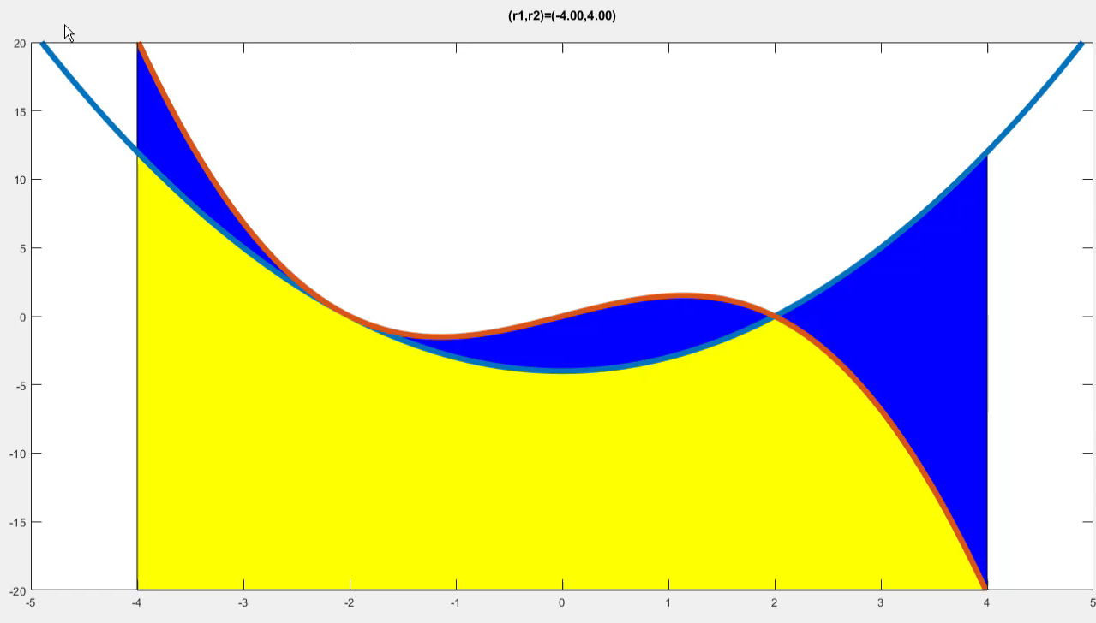
Problem 2.2. Option 2.
Play to see the demo

Slide 25
Problem 2.2. Marking Scheme
The items must be done correctly.
Option 1. (F=[k11; k12; k21; k22; k23; k24; k31; k32; k33; k41; k42; k51];)
[2*12%]: Each mesh is correct; its title is correct; and the axis range is correct.
[5%]: ‘m’ and ‘n’ work well.
[1%]: Press ‘q’ to show the student ID and name. Then quit the program.
We will not modify your script. If your program does not support ‘n’ and ‘m’, your score is zero.

Slide 26
Problem 2.2. Marking Scheme
Option 2.
[2%] : The two curves are correct and they are on top of the filled regions.
[2%] : The title is correct.
[5%]: The (blue) region(s) between the two curves is/are filled correctly, e.g.,
(r1,r2) = (-1, -1), (r1,r2) = (-2, -1), (r1,r2) = (2, 3), (r1, r2) = (3, 3), etc.
[4%]: The (yellow) region below the two curves is filled correctly.
[2%]: Press ‘n’ to change r1 and the result is correct.
[2%]: Press ‘m’ to change r2 and the result is correct.
[1%]: r1 is smaller than or equal to r2.
[1%]: Press ‘b’ to reset r1 and r2. All the results are correct.
[1%]: Press ‘q’ to show the student ID and name. Then quit the program.

Slide 27
End
Enjoy MATLAB Programming.

